Slide 1
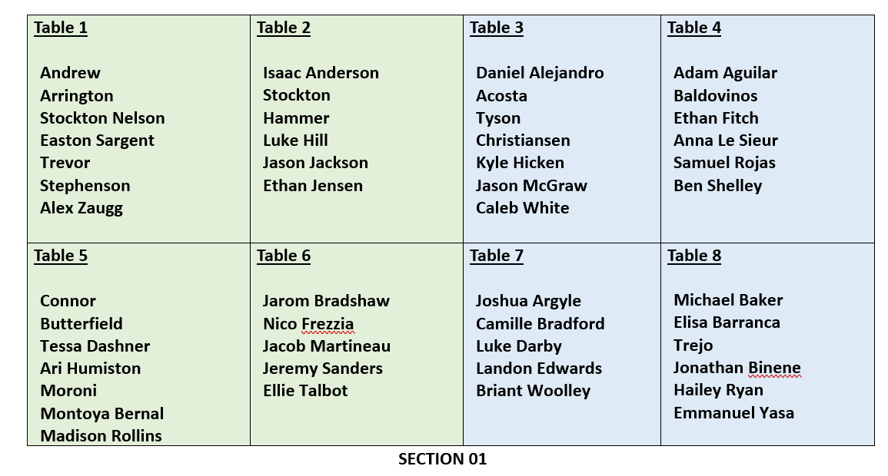

Slide 2

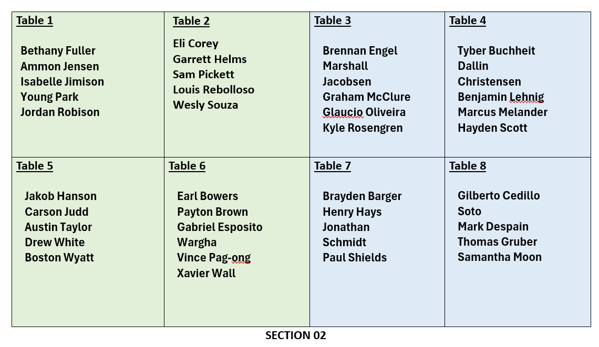


Slide 3
CSE 170 Technical Teamwork Fall 2024
Making you awesome – so you can be a better teammate.

Slide 4
Opening Prayer

Slide 5
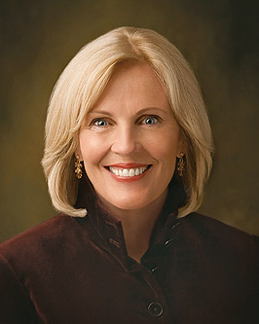
Spiritual Thought
Did you know that Heavenly Father knows you personally—by name? The scriptures teach us that this is true. When Enos went into the woods to pray, he recorded, “There came a voice unto me, saying: Enos, thy sins are forgiven thee, and thou shalt be blessed.” Moses not only prayed but also talked to God face-to-face, and God said to Moses, “I have a work for thee, Moses, my son.”
You may not have heard the Lord call you by name, but He knows each one of you and He knows your name. Elder Neal A. Maxwell said: “I testify to you that God has known you individually … for a long, long time. He has loved you for a long, long time. He not only knows the names of all the stars, He knows your names and all your heartaches and your joys!”
Elaine S. Dalton – He Knows You By Name - Apr. 2005

Slide 6

Names!
Learning your name is important to me – I’m working on it!
One thing that helps me a lot is the seating chart which will be finalized next week.
Groups will be finalized at the end of this week and a final seating chart will be shown at the beginning of class.
This Photo by Unknown Author is licensed under CC BY-SA

Slide 7

Agenda
Self-Awareness
Improving self awareness
Assignments
Review assignments and due dates
Initial the roll
Kevin Porter case study
Teamwork Skills Self-Assessment
Metacognition, Introspection, Rumination
Announcements

Slide 8
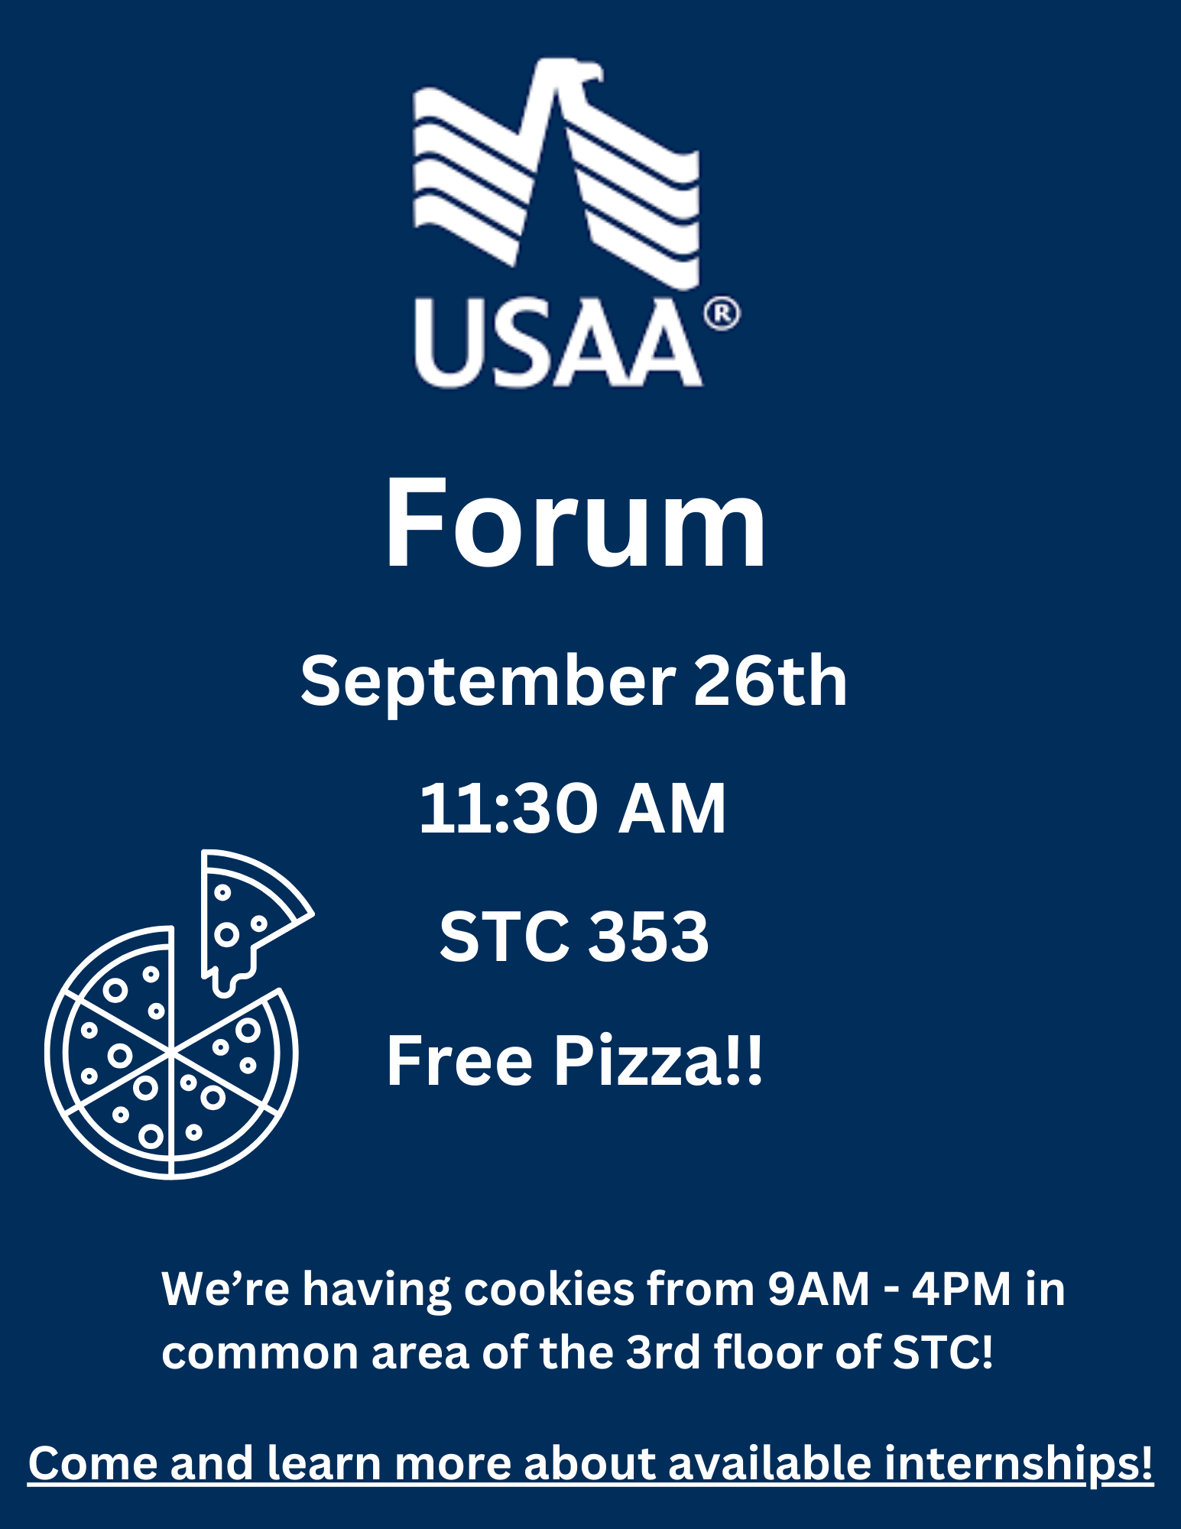

Slide 9
Assignments
U02 Prepare: Articulate
Answer 4 questions about self-awareness
Due Wed. 9/25
U02 Prove 0: Teamwork Skills
Answer a self-assessment about your teamwork skills and abilities
Due Wed. 9/25
U02 Teach: Analyze (Discussed in class)
Answer a question about the Phillip Walker case study
Due Sat. 9/28

Slide 10
U02 Prepare: Teamwork Skills
Let’s review this briefly.

Slide 11




Improving Self-Awareness

Slide 12

Metacognition
Metacognition – thinking about your thinking processes
Includes a goal of improving learning and problem-solving.
Example: What can I do to remember names of people I meet better?
What examples of “metacognition” can you think of?
This Photo by Unknown Author is licensed under CC BY-NC

Slide 13

Introspection
Introspection – self-examination, focusing on thoughts, feelings, and inner experiences,
Has the goal of self-understanding and personal growth.
Sometimes talking through our emotions with others can help us understand them better.
Example: What can I do to become better at interacting with others in my ward?
This Photo by Unknown Author is licensed under CC BY-NC

Slide 14

Rumination
Rumination – repetitive and unproductive thinking, often centered on negative or distressing thoughts
There is no clear problem-solving or self-understanding purpose
This can lead to negative emotional outcomes.
Example: Why does everyone hate me?

Slide 15
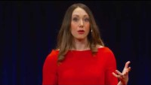
Tasha Eurich: Increase Self-Awareness With One Simple Fix

Slide 16

Improving Self-Awareness Using “What Questions”
On your table is a “WHY” question.
In your table group answer these two questions:
How does this WHY question lead to poor outcomes?
How can I change this WHY question into a WHAT question?
Appoint a spokesman for your table

Slide 17

Kevin Porter 5-minute review
Let’s take 5 minutes to review the contents of the Kevin Porter case study.
You can find this in the U02 Teach: Analyze - Wk 2 assignment.
This Photo by Unknown Author is licensed under CC BY-NC

Slide 18
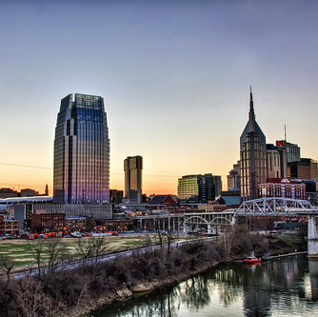
Kevin Porter – The Scenario
Describe Kevin’s first job out of college with Slick Tix.
How does Kevin feel about the sales job that he’s good at?
How are Kevin’s relationships in Nashville going?
What self-destructive habits has Kevin taken on?
Why is Kevin on the verge of being let go?
This Photo by Unknown Author is licensed under CC BY-NC-ND

Slide 19

Group Discussion – The Decision
How is Kevin’s lack of self-awareness creating problems in his life?
What choices are available to Kevin at this point in his career?
What are the consequences of each choice he might make?
What would you do if you were Kevin?
Appoint a spokesperson for your table.

Slide 20

Next Time
More Self-Awareness Tools
Your Personal User Manual

